Slide 1
Chapter 1: History of Cryptography to 1800s

Slide 2
What Is Cryptography?
The process or skill of communicating in, or deciphering, secret writings or ciphers
Secret writing

Slide 3
What Is Cryptography?
Cryptography (or cryptology): Derived from the word kryptós, which means “hidden,” and the verb gráfo, which means “write.”
It is the study of message secrecy.

Slide 4
What Is Cryptography?
Now that you have seen a few dictionary definitions of cryptography, let’s synthesize a complete definition:
Cryptography is the science of altering communication so that it cannot be understood without having the key.

Slide 5
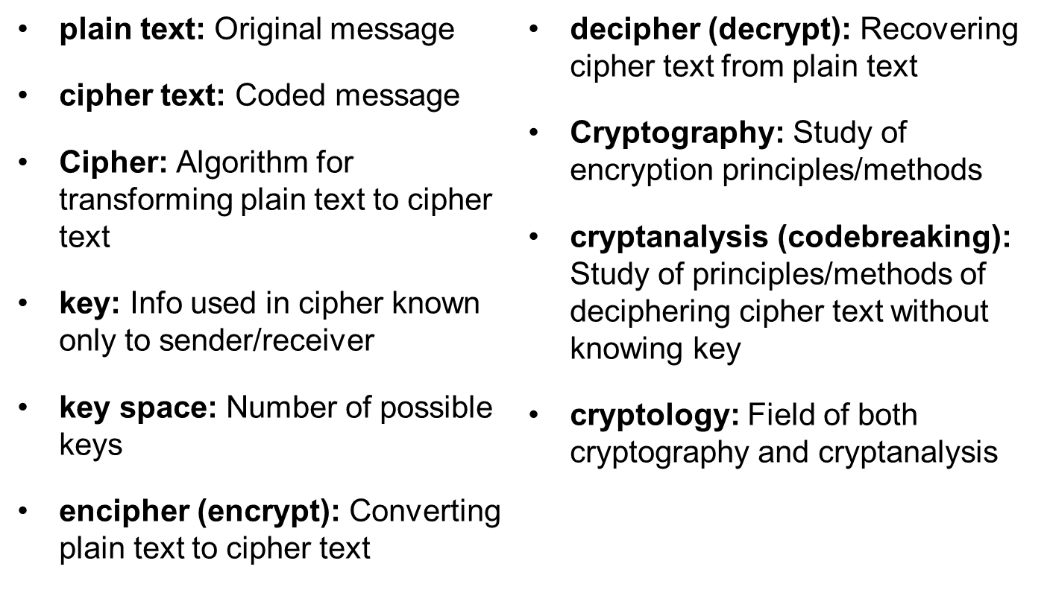
Some Basic Terminology
Notes:
Briefly review some terminology used throughout the course.

Slide 6
History
Hidden or secret writing is very old. There has always been a need to have hidden communications, and people have been practicing hidden writing for at least 3000 years. Until the latter part of the 20th century, this was used almost exclusively for military and government purposes.
This section covers historical cryptographic methods that led to today’s modern cryptography. Of the many ciphers that you can study, we will focus on those that have been the most influential in the history of cryptography.

Slide 7
Caesar Cipher
This cipher was first used by Julius Caesar.
Every letter is shifted a fixed number of spaces to the left or right in the alphabet. Caesar purportedly shifted three to the right, but you can use any number or direction.
The shifting is the “key” for this algorithm.

Slide 8
Caesar Cipher
The shift is often called the “alphabet” being used. The Caesar cipher is an example of a single alphabet substitution because all letters are shifted by the same amount.
  Attack at dawn
becomes
  Dwwdfn dw gdzq

Slide 9
Atbash Cipher
Hebrew scribes copying the book of Jeremiah used this cipher. It is, by modern standards, a primitive and easy to break cipher. But it will help you get a feel for how cryptography works.
The Atbash cipher is a Hebrew code that substitutes the first letter of the alphabet for the last and the second letter for the second to the last, and so on. It simply reverses the alphabet.
A becomes Z, B becomes Y, C becomes X, and so on.

Slide 10
Atbash Cipher Example
A cat sleeps
  becomes
Z xzg hovvkh
This is a simple cipher and is not used in modern times. However, it illustrates the basic concept of cryptography: to perform some permutation on the plain text to render it difficult to read by those who don’t have the key to “unscramble” the cipher text.

Slide 11
Affine Ciphers
An affine cipher is any single-substitution alphabet cipher (also called mono-alphabet substitution) in which each letter in the alphabet is mapped to some numeric value, permuted with some relatively simple mathematical function, and then converted back to a letter. For example, in the Caesar cipher, each letter is converted to a number, shifted by some amount, and then converted back to a letter.
The basic formula for an affine cipher is
  ax + b (mod M)

Slide 12
Affine Ciphers
M is the size of the alphabet; in English that equals 26.
The x represents the plain text letter’s numeric equivalent, and the b is the shift.
The a is some multiple; in the case of the Caesar cipher, that is 1.
So the Caesar cipher, as used by Julius Caesar, would be
  1x + 3 (mod 26)

Slide 13
ROT 13
This is another single-alphabet substitution cipher. All characters are rotated 13 characters through the alphabet.
The phrase
  A CAT
becomes
  N PNG

Slide 14
Homophonic Substitution
Homophonic substitution was one of the earlier attempts to make substitution ciphers more robust by masking the letter frequencies. Plain text letters map to more than one cipher text symbol.
Having a single character of plain text map to more than one character of cipher text makes it more difficult to analyze homophonic substitution ciphers. Further complicating this by using symbols rather than characters can make this even more difficult to analyze.

Slide 15
Homophonic Substitution
The nomenclator combined a codebook that had a table of homophonic substitutions.
Originally the codebook used only the names of people, thus the term nomenclator. So, for example, Mr. Smith could be XX and Mr. Jones could be XYZ.

Slide 16
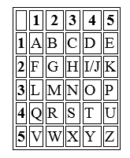
Polybius Cipher
The Polybius cipher (also known as the Polybius square) was invented by the Greek historian Polybius (c. 200 to 118 BCE). Obviously his work used the Greek alphabet, but we will use it with English here.

Slide 17
Polybius Cipher
Each letter is represented by two numbers, the x and y coordinates of that letter on the grid.
For example, A is 1 1, D is 1 4, and R is 4 2.
So to write the word attack you would use this:
114444111325

Slide 18
Null Cipher
Essentially the message is hidden in unrelated text. So you might send a message such as
  “We are having breakfast at noon at the café. Would that be okay?”
The sender and recipient have prearranged to use some pattern, taking certain letters from the message. So, for example, applying the following pattern to the previous sentence
  3, 20, 22, 27, 32, 48
would give the word
  “attack”

Slide 19
Poly-alphabetic Substitution
The obvious way to make substitution ciphers (such as Atbash and Caesar) stronger is to rotate through various alphabets. Any substitution using multiple alphabets, such as using three alphabets such as +1 –1 +2.
Then the phrase
  A CAT
becomes
  B BCA
The first letter is add 1, then the second is subtract 1. The third is add 2, and then for the fourth letter you start over.

Slide 20
Poly-alphabetic Substitution
These ciphers break up the letter and word frequency, making them harder to break than single-substitution ciphers. In fact, for a human using a pen and paper, it may be too difficult to crack.
Examples of poly-alphabetic substitution include
Tabula recta
Vigenère
Beaufort

Slide 21
Tabula Recta
Johannes Trithemius described this in his book Polygraphia, which is presumed to be the first published book on cryptology.
You simply take the plain text and substitute it for the letter that appears beneath it. Basically the first letter of the plain text (denoting the row) is matched with the first letter of the keyword (denoting the column), and the intersection of the two forms the cipher text. This is repeated with each letter. When the end of the keyword is reached, you start over at the beginning of the keyword.

Slide 22
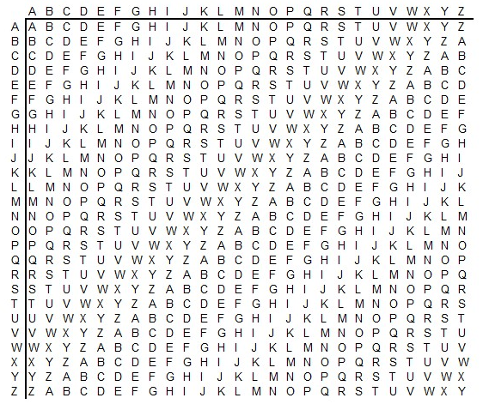
Tabula Recta

Slide 23
Vigenère Cipher
Perhaps the most widely known poly-alphabet cipher is the Vigenère cipher.
It is a method of encrypting alphabetic text by using a series of different mono-alphabet ciphers selected based on the letters of a keyword.
This cipher was invented in 1553 by Giovan Battista Bellaso. It was later misattributed to Blaise de Vigenère, and so it is now known as the Vigenère cipher, even though Vigenère did not really invent it.

Slide 24
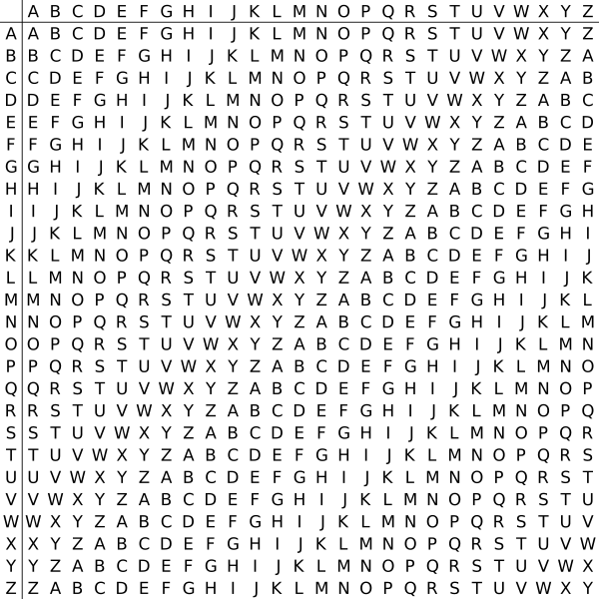
Vigenère Cipher Example
Match the letter of your keyword on the top with the letter of your plain text on the left to find the cipher text.

Slide 25
Vigenère Cipher Example
Using the chart, if you are encrypting the word
  cat
and your keyword is
  horse
then the cipher text is
  jok

Slide 26
Vigenère Cipher Example
This is a very effective multi-alphabet cipher, and prior to the advent of computers it was considered quite strong.
Note that the longer the keyword, the more alphabets are used to encrypt the message, and thus the stronger the encryption.
In fact, you do not even need to use a real word. Any series of letters will work.

Slide 27
Beaufort Cipher
This cipher was created by Sir Francis Beaufort (1774 to 1857). It is similar to the Vigenère cipher and also uses a tabula recta.
You select a keyword, but unlike Vigenère, you will locate your plain text in the top row, and move down until you find the matching letter of the keyword; then pick the letter farthest to the left as the cipher text.

Slide 28
Cipher Disk
The cipher disk was invented by Leon Alberti in 1466.
The cipher disk was polyalphabetic: each time you turned the disk you used a new cipher. It was a literal disk that was turned to encrypt plain text.

Slide 29
Scytale
The Scytale cipher is often mispronounced. It is not pronounced like “sky tale” but rhymes with “Italy.”
This cipher used a cylinder with a strip of parchment wrapped around it. If you had the correct diameter cylinder, when the parchment was wrapped around it, the message would be decoded.

Slide 30
Jefferson Disk
This disk, which was called a wheel cipher by Thomas Jefferson, is a rather complex device, at least for its time. It was invented by Jefferson in 1795. It is a set of wheels or disks, with each disk containing the entire 26 letters of the English alphabet. The disks revolve on a central axle and can be rotated about the axle. The order of the disks is the key: both sender and receiver must order their disks correctly.
The sender rotates the letters on the disks until the desired message is spelled out in a single row. The message is then written on paper or parchment and sent to the recipient. The recipient arranges the disks according to the predefined order and then rotates them until the message is displayed.

Slide 31
Book Ciphers
Book ciphers have been around for probably as long as there have been books. Both parties agree to use a particular book as the basis.
The simplest implementation is to send coordinates for words. So, for example, 3, 3, 10 means to go to page 3, line 3, and the 10th word. In this way, you can specify words with coordinates and write out entire sentences.
There are numerous variations. For example, you could combine book ciphers with Vigenère and use the book coordinates to denote the keyword for Vigenère.

Slide 32
Rail Fence Cipher
The rail fence cipher may be the most widely known transposition cipher. You take the message you want to encrypt and alter each letter on a different row. So “attack at dawn” is written as
  A t c a d w
  t a k t a n
Next you write down the text reading from left to right as one normally would, thus producing
  Atcadwtaktan
To decrypt the message, the recipient must write it out on rows:
  A t c a d w
  t a k t a n
Then the recipient reconstructs to original message. Most texts use two rows as examples, but this can be done with any number of rows.

Slide 33
Geometric Shape
With this cipher, you write out the plain text in rows and then map a path through it (that is, a shape) to create the cipher text. So, if the plain text is “attack the beach at sunrise,” you first write this message out in rows as shown here:
  A t t a c k t
  h e b e a c h
  a t s u n r i s e
Then pick some path through the message to create the cipher text.

Slide 34
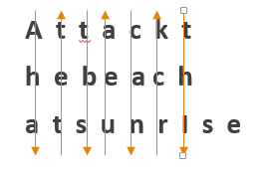
Geometric Shape Cipher

Slide 35
Columnar Cipher
This is a very intriguing type of transposition cipher. The text you want to encrypt is written in rows, usually of a specific length determined by some keyword. For example, if the keyword is “falcon,” which is six characters long, you would write out your messages in rows of six characters each. So if your message is “attack the beach at sunrise,” you would write out
  a t t a c k
  t h e b e a
  c h a t s u
  n r i s e q

Slide 36
Columnar Cipher
For the keyword falcon, the order is 3 1 4 2 6 5, as f is the third “lowest” letter in the keyword, a is the lowest, l is the fourth lowest, and so on. So, if we apply 314265, we first write down column 3, then column 1, then column 4, then column 2, then column 6, and then column 5.
  a t t a c k
  t h e b e a
  c h a t s u
  n r i s e q
produces
  teaiatcnabtskauqcese

Slide 37
Myskowski Variation
When using a columnar cipher, what happens if the keyword has two of the same letter?
Normally you treat the second occurrence as if it were the next letter. For example, if babe is the keyword, the second b is treated as if it were a c, so the order would be 2, 1, 3, 4.
However, Emile Myskowski proposed a variation that did something different. The repeated letters were numbered identically, so babe would be 2, 1, 2, 3. Any plain text columns that had unique numbers (in this case 1 and 3) would be transcribed downward as per usual. However, the recurring numbers (in this case 2) would be transcribed left to right.

